Slide 1
Magnetic Control of Liquid Mirrors in Microgravity
August 25
Álvaro Romero-Calvo, Ph.D.
DARPA Zenith Lecture 3

Slide 2
Ferrofluids
An overview

Slide 3
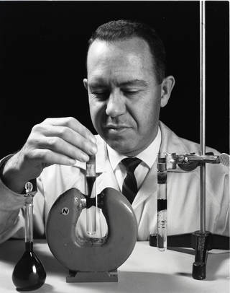
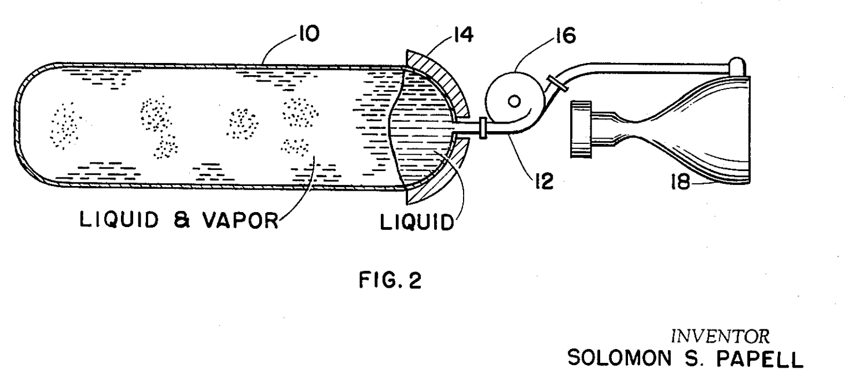
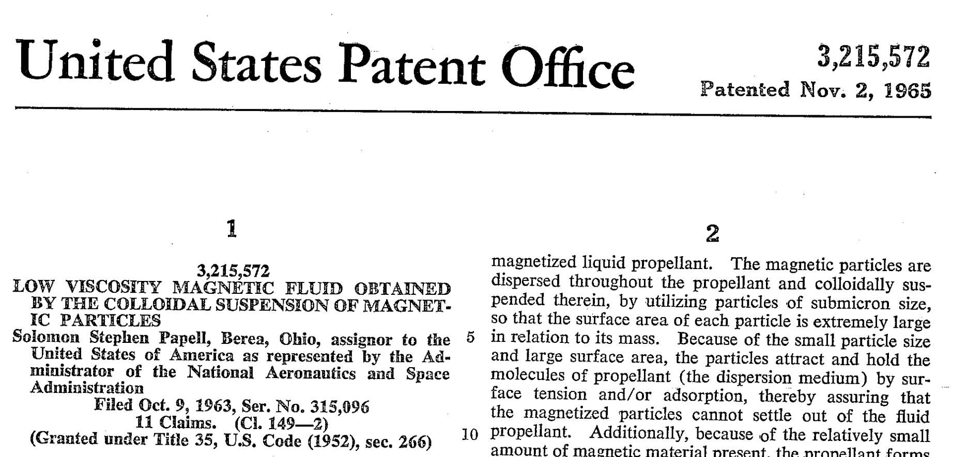
The origins

Slide 4
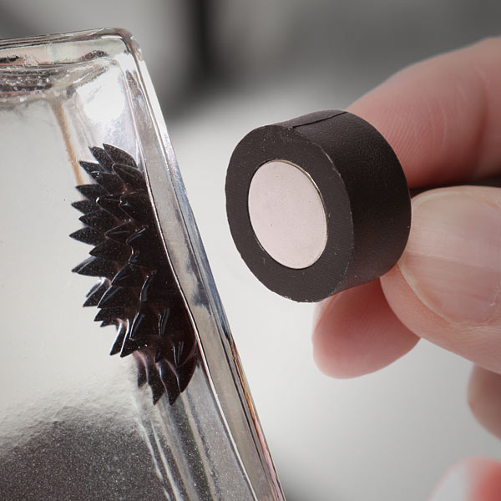
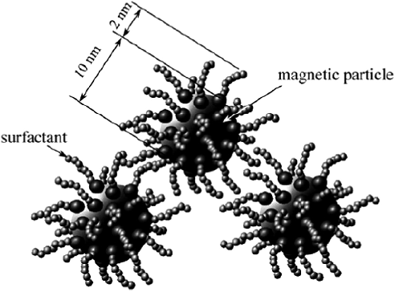
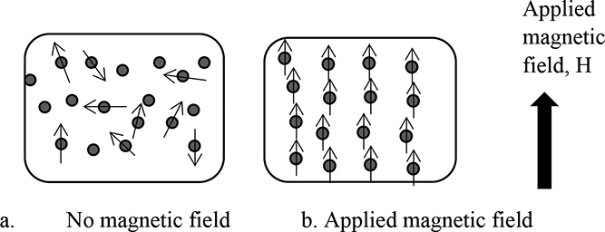
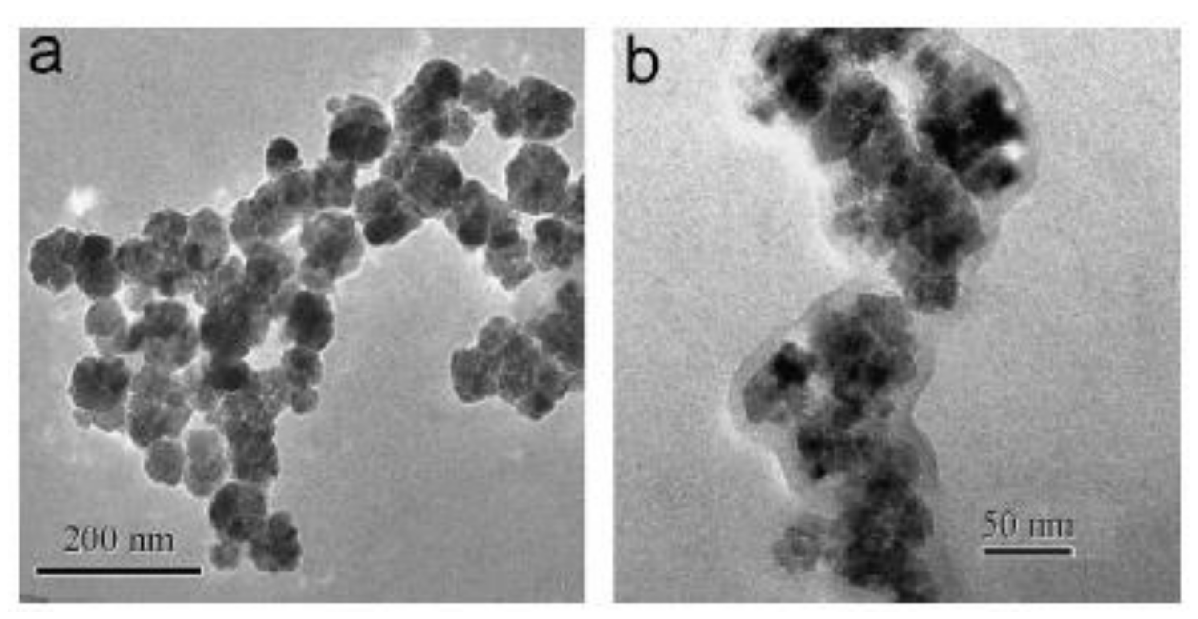
Colloidal suspensions of magnetic nanoparticles

Slide 5
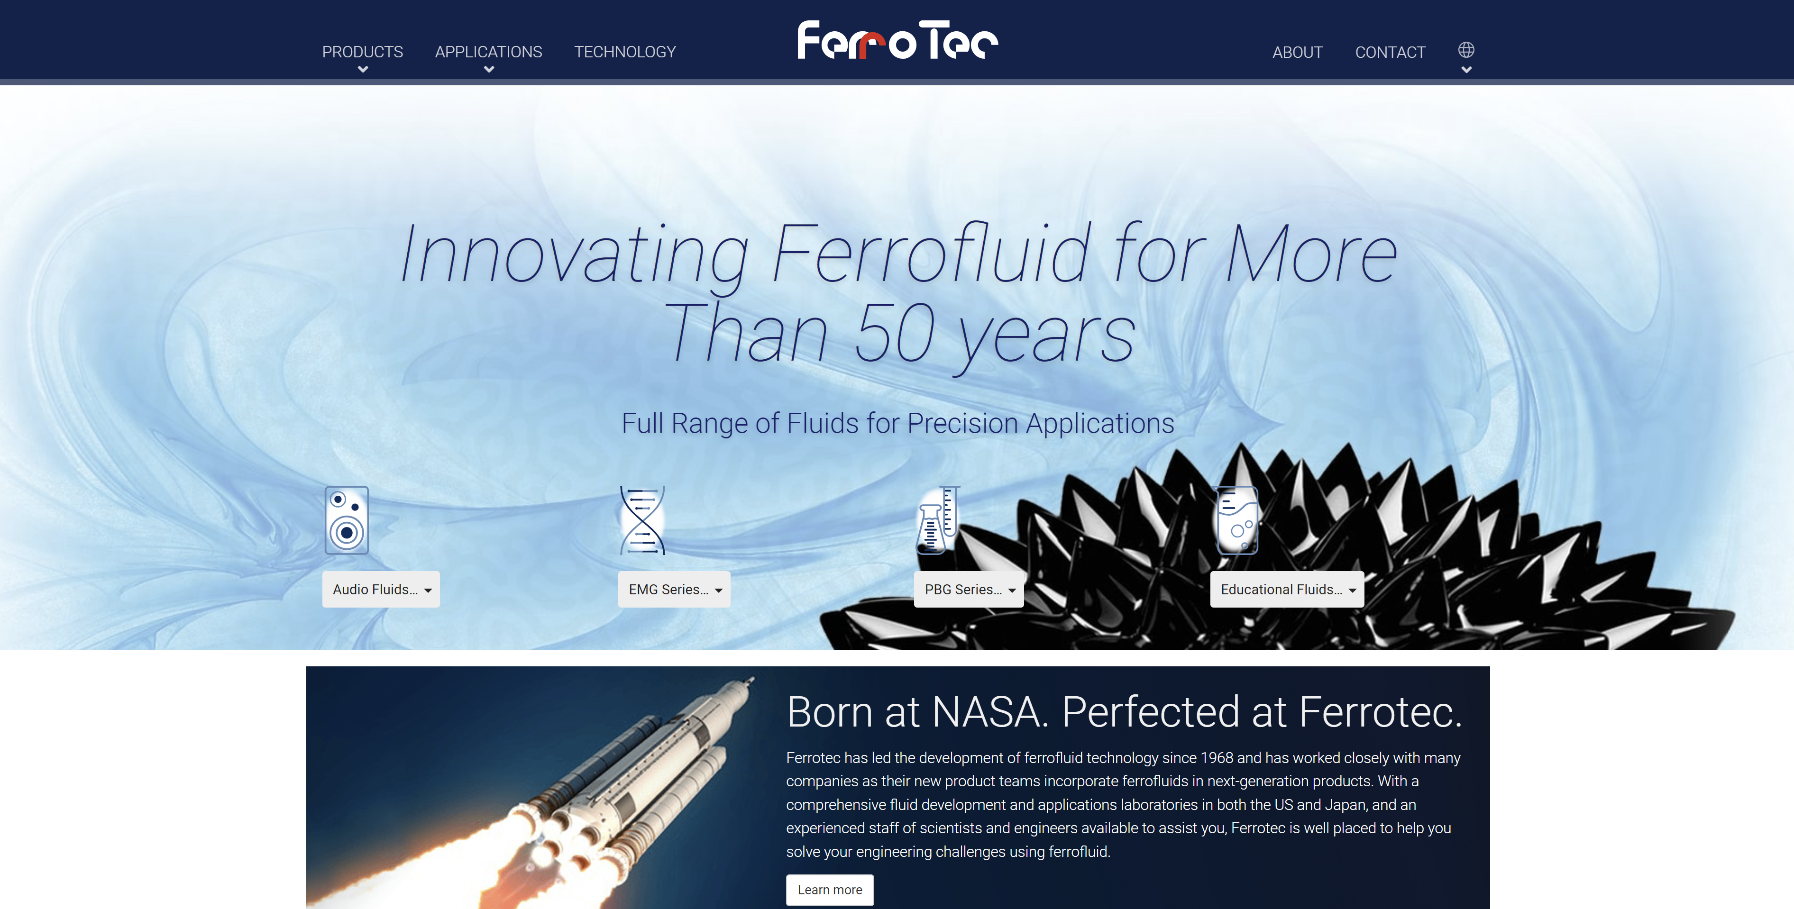

Slide 6
Ferrohydrodynamics
Theory of ferrofluids

Slide 7
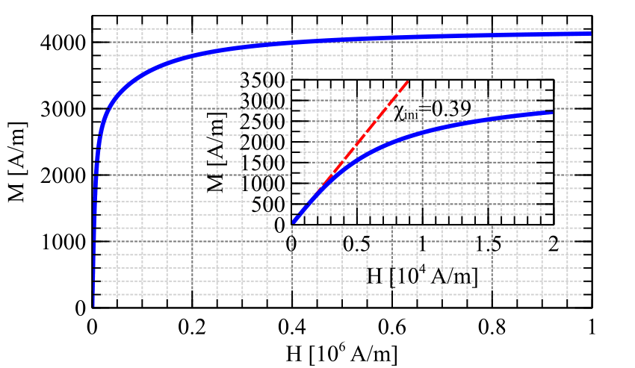
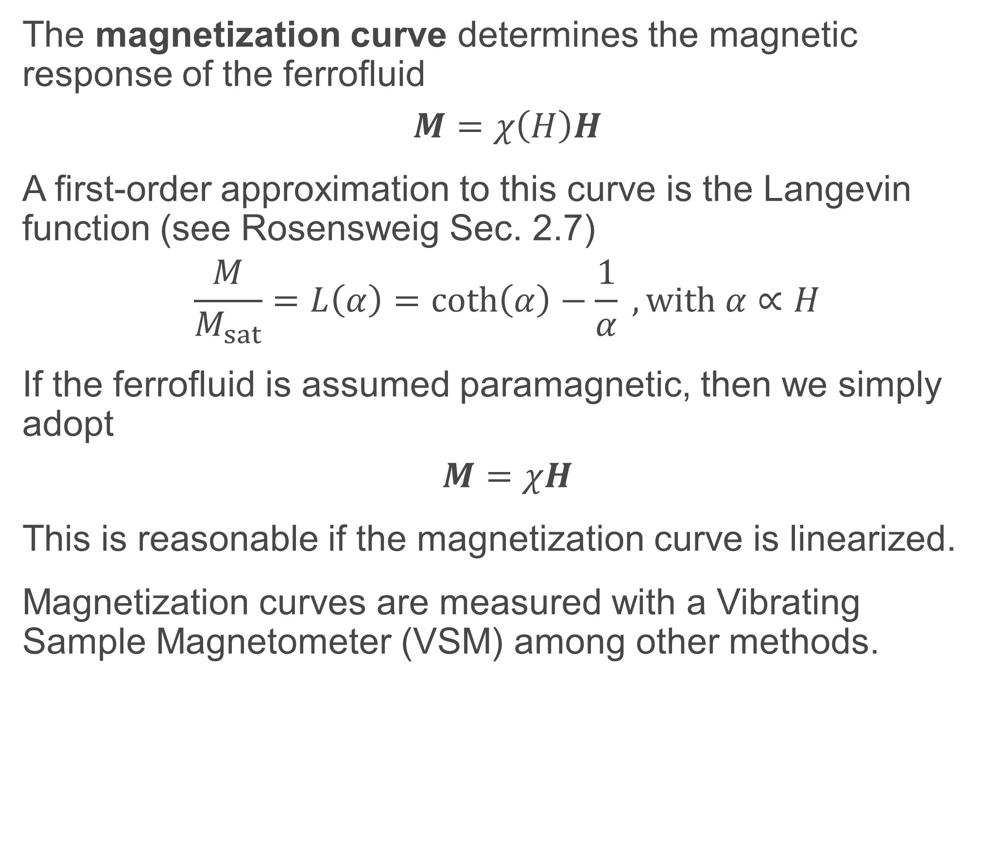
Ferrofluid characterization
The magnetization curve determines the magnetic response of the ferrofluid
$$M=χ\left(H\right)H$$
A first-order approximation to this curve is the Langevin function (see Rosensweig Sec. 2.7)
$$\frac{M}{M_{sat}}=L\left(α\right)=coth\left(α\right)−\frac{1}{α} , with α∝H$$
If the ferrofluid is assumed paramagnetic, then we simply adopt
$$M=χH$$
This is reasonable if the magnetization curve is linearized.
Magnetization curves are measured with a Vibrating Sample Magnetometer (VSM) among other methods.

Slide 8
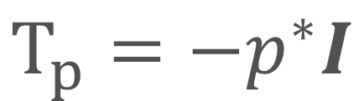
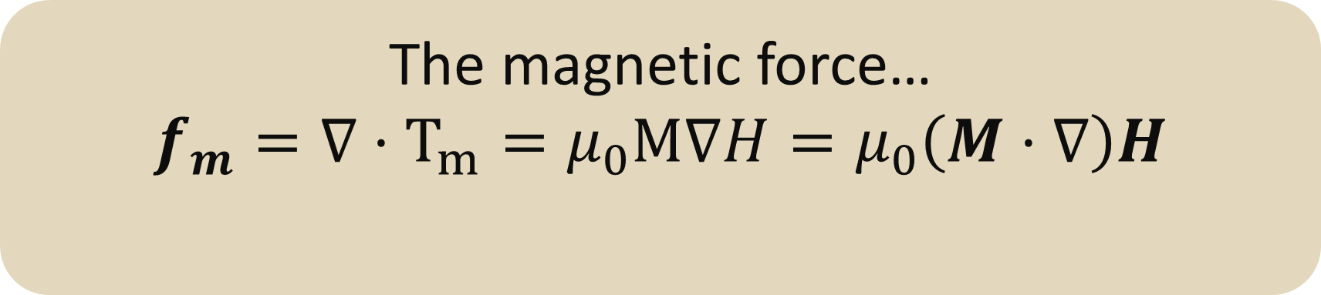
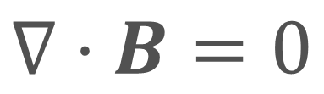
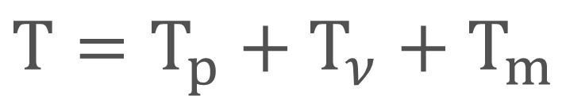
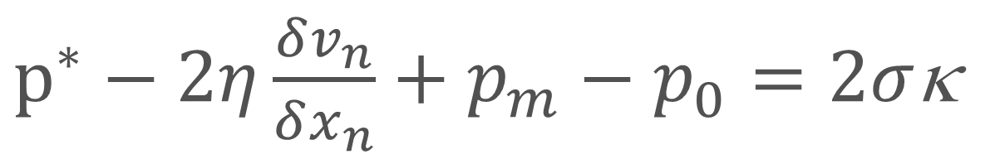
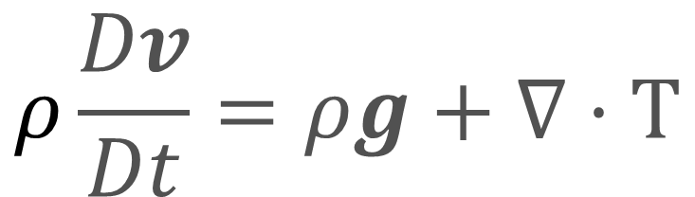
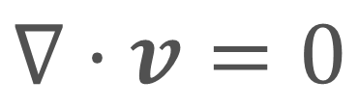
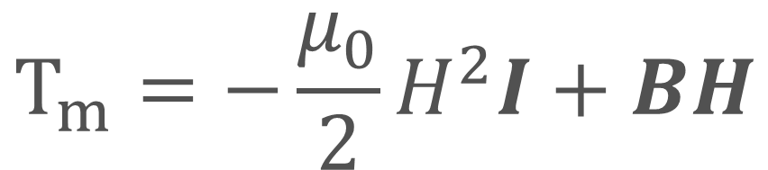
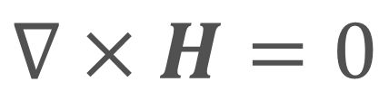
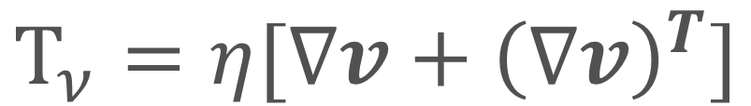
Fluid-magnetic coupling
Incompressible, electrically neutral, viscous fluids
Incompressible, viscous Maxwell stress tensor
$$∇·v=0$$
$$T=T_{p}+T_{ν}+T_{m}$$
$$ρ\frac{Dv}{Dt}=ρg+∇·T$$
$$T_{p}=−p^{∗}I$$
$$T_{ν}=η[∇v+{\left(∇v\right)}^{T}]$$
$$T_{m}=−\frac{μ_{0}}{2}H^{2}I+BH$$
Static magnetic fields inside the fluid
$$∇·B=0$$
Coupled problems!*
$$∇×H=0$$
* For para/diamagnetic liquids $H≈H_{0}$ and the fluid/magnetic system uncouples
Normal fluid-magnetic surface balance
The magnetic force…
$$f_{m}=∇·T_{m}=μ_{0}M∇H=μ_{0}\left(M·∇\right)H$$
$p^{∗}−2η\frac{δv_{n}}{δx_{n}}+p_{m}−p_{0}=2σ$κ
$$p_{m}=n·T_{m}^{+}−n·T_{m}^{−}=μ_{0}M_{n}^{2}/2n$$
Romero-Calvo Á., “Novel Electromagnetic Space Applications: Touchless Potential Sensing and Low-Gravity Ferrohydrodynamics”, PhD Thesis, University of Colorado Boulder
Romero-Calvo Á et al., “Total magnetic force on a ferrofluid droplet in microgravity”, Experimental Thermal and Fluid Science, Vol. 117, 1 2020, 110124

Slide 9
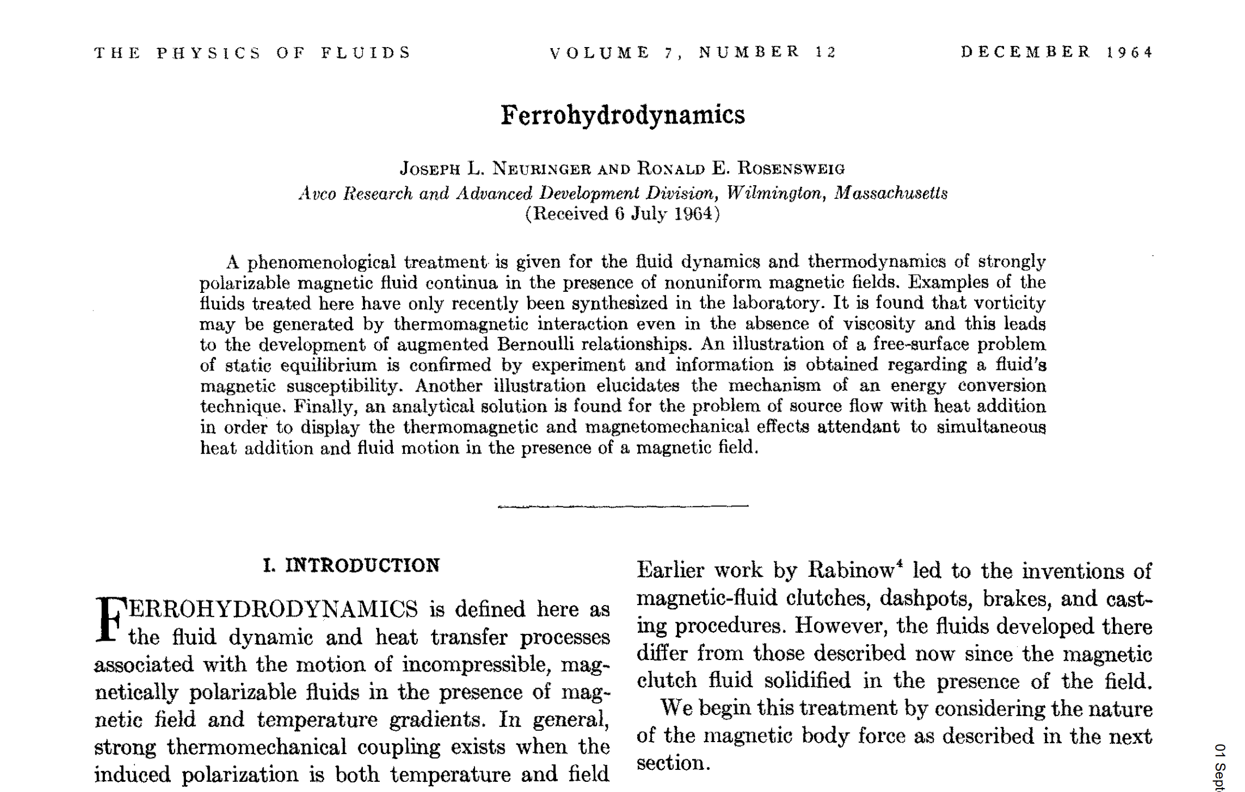
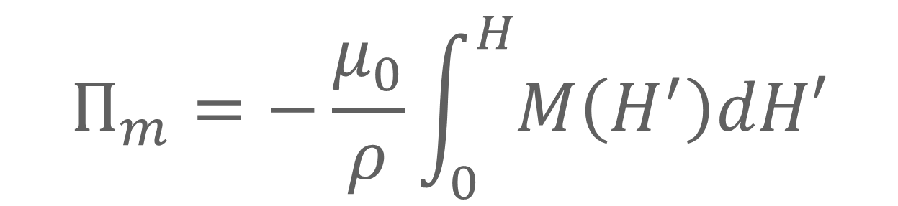
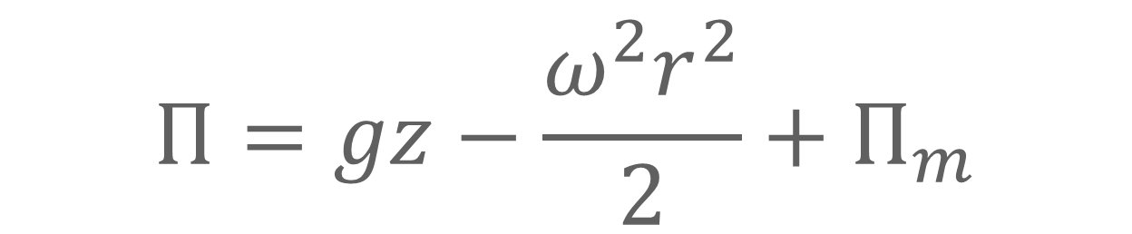
Magnetic force potential
$$Π=gz−\frac{ω^{2}r^{2}}{2}+Π_{m}$$
Isothermal
$$Π_{m}=−\frac{μ_{0}}{ρ}\int_{0}^{H}{M\left(H^{′}\right)dH′}$$
https://pubs.aip.org/aip/pfl/article/7/12/1927/825415/Ferrohydrodynamics

Slide 10
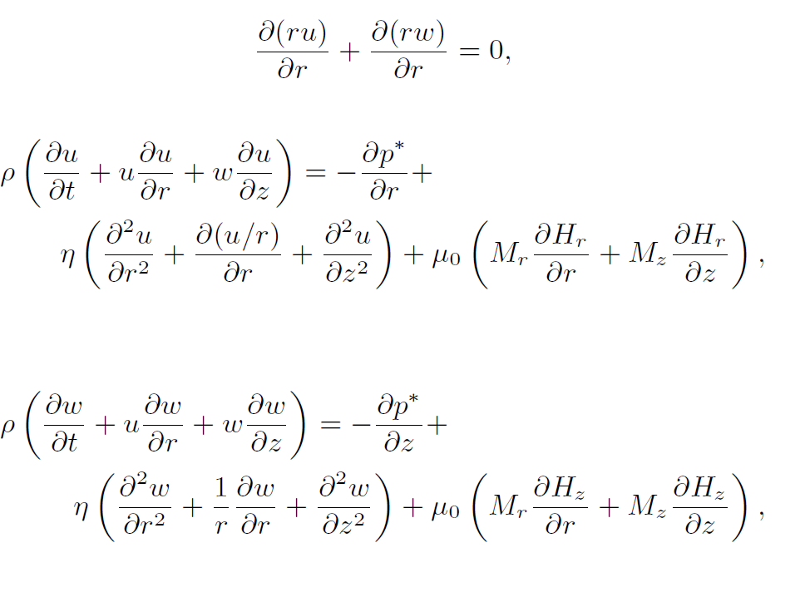
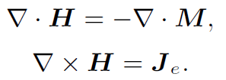
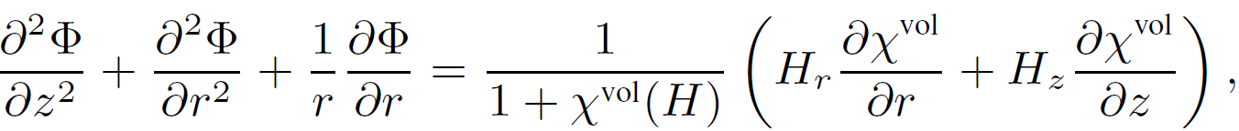
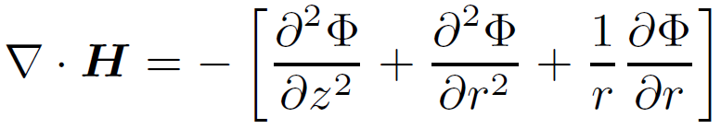
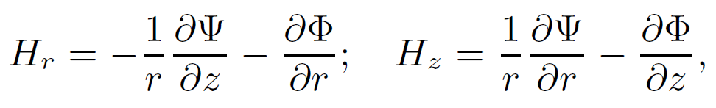
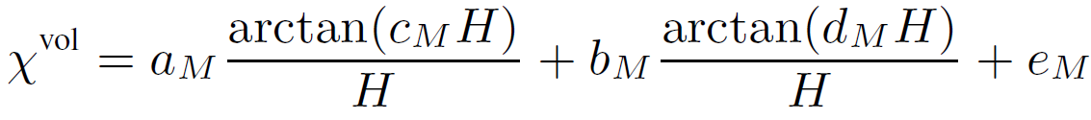
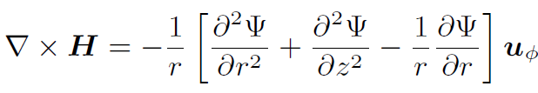

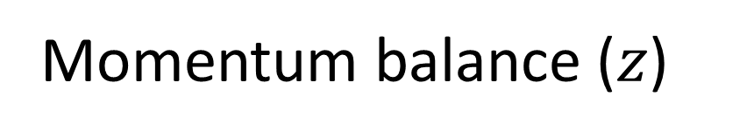
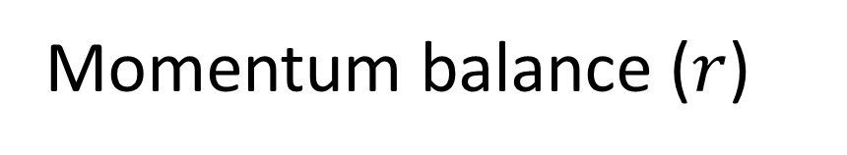
Governing equations for axisymmetric flows
Navier-Stokes equations (fluid domains)
Mass balance
Momentum balance ($r$)
Momentum balance ($z$)
Magnetostatic Maxwell equations (all domains)
For fluid domain
Constitutive Relation
$ψ$ is uncoupled!!
Romero-Calvo Á et al., “Coupled Monolithic Magnetohydrodynamic Model for Axisymmetric Multiphase Flows”, Applied Mathematical Modeling, Vol. 111, pp. 836-861, 2022
Notes:
Uncoupling is relevant for definition of domains!! Since psi is uncoupled, we can simplify A LOT the analysis

Slide 11
Tasks

Slide 12
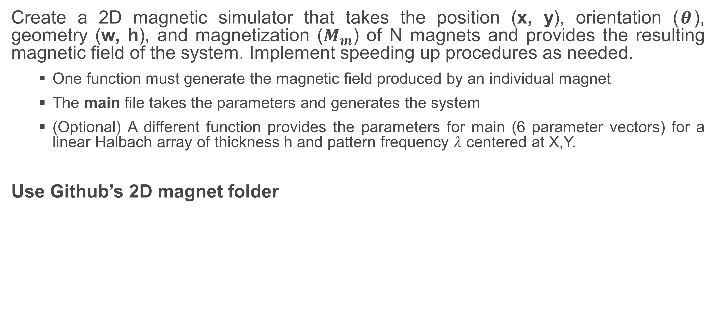
Task 1
Create a 2D magnetic simulator that takes the position (x, y), orientation ($θ$), geometry (w, h), and magnetization ($M_{m}$) of N magnets and provides the resulting magnetic field of the system. Implement speeding up procedures as needed.
One function must generate the magnetic field produced by an individual magnet
The main file takes the parameters and generates the system
(Optional) A different function provides the parameters for main (6 parameter vectors) for a linear Halbach array of thickness h and pattern frequency $λ$ centered at X,Y.
Use Github’s 2D magnet folder

Slide 13
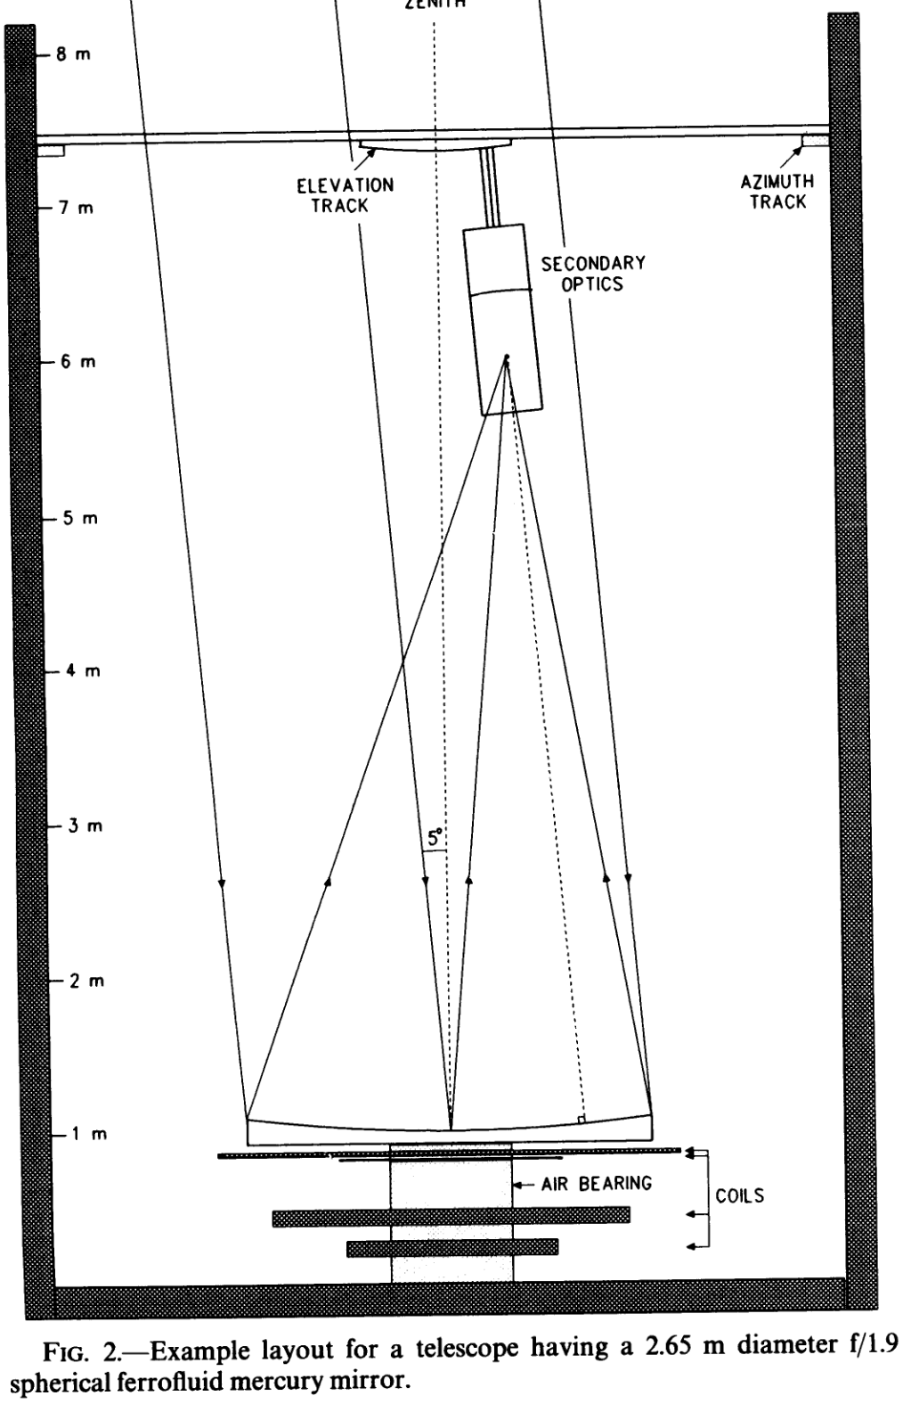
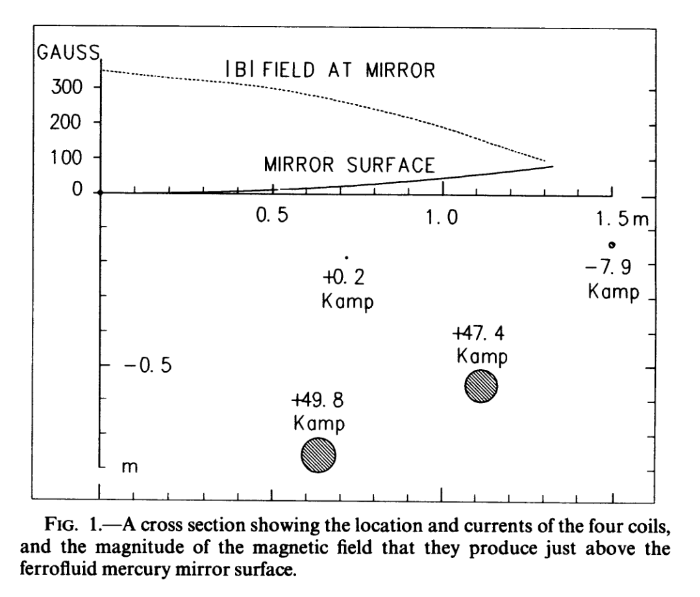
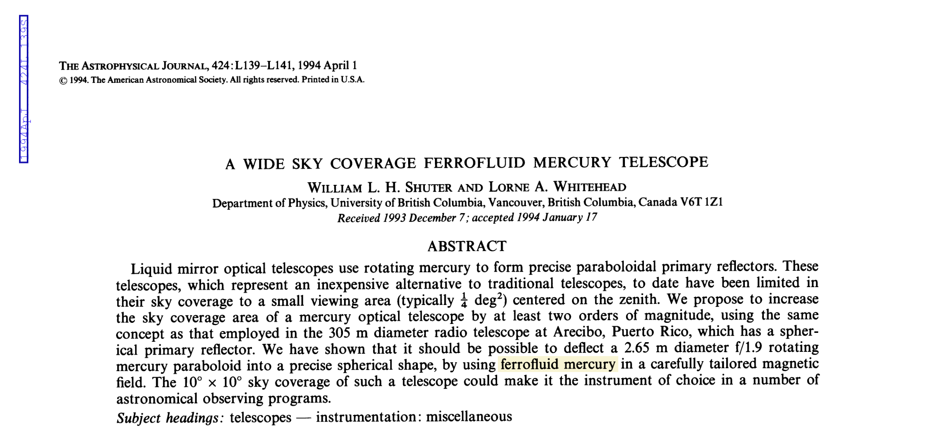
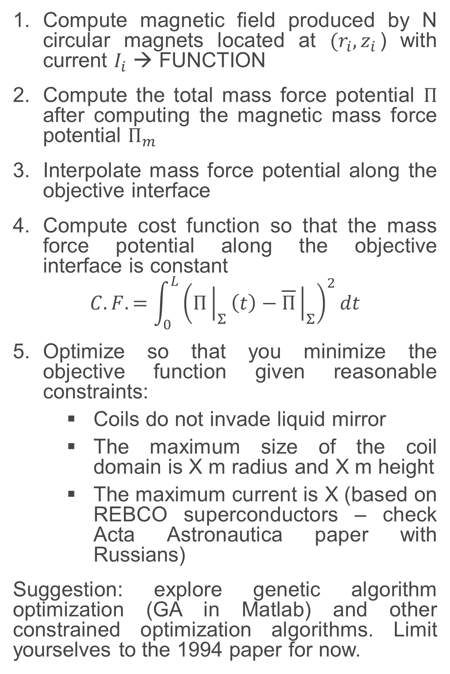
Task 2
Compute magnetic field produced by N circular magnets located at $(r_{i},z_{i}$) with current $I_{i}$ → FUNCTION
Compute the total mass force potential $Π$ after computing the magnetic mass force potential $Π_{m}$
Interpolate mass force potential along the objective interface
Compute cost function so that the mass force potential along the objective interface is constant
$$C.F. =\int_{0}^{L}{{\left(Π{\left.​\right|}_{Σ}\left(t\right)−\overline{Π}{\left.​\right|}_{Σ}\right)}^{2}}dt$$
Optimize so that you minimize the objective function given reasonable constraints:
Coils do not invade liquid mirror
The maximum size of the coil domain is X m radius and X m height
The maximum current is X (based on REBCO superconductors – check Acta Astronautica paper with Russians)
Suggestion: explore genetic algorithm optimization (GA in Matlab) and other constrained optimization algorithms. Limit yourselves to the 1994 paper for now.

Slide 14
Questions?
DARPA Zenith Lecture 1

